Slide 1
HTML Introduction
By M.Guhan

Slide 2
What is HTML?
HTML stands for Hyper Text Markup Language
HTML is the standard markup language for creating Web pages
HTML describes the structure of a Web page
HTML consists of a series of elements
HTML elements tell the browser how to display the content
HTML elements label pieces of content such as "this is a heading", "this is a paragraph", "this is a link", etc.

Slide 3
html history and versions
Year | Version
1991 | Tim Berners Lee invented HTML
1993 | Dave Raggett drafted HTML+
1995 | HTML Working Group defined HTML 2.0
1997 | W3C Recommendation: HTML 3.2
1999 | W3C Recommendation: HTML 4.01
2000 | W3C Recommendation: XHTML 1.0
2008 | WHATWG HTML5 First Public Draft
2012 | WHATWG HTML5 Living Standard
2014 | W3C Recommendation: HTML5
2016 | W3C Candidate Recommendation: HTML 5.1
2017 | W3C Recommendation: HTML5.1 2nd Edition
2017 | W3C Recommendation: HTML5.2

Slide 4
Structure of an HTML Document
<html>: The Root Element
The <html> element is the root element of the HTML document. Everything inside this element is considered part of the HTML document.
<head>:Metadata of the Document
The <head> section contains metadata about the document that isn't displayed on the webpage.
This section includes important elements like <meta charset="UTF-8">, <metaname="viewport" content="width=device-width, initial-scale=1.0">
<body>:Visible Content of the Webpage
The <body> tag contains the actual content of the webpage that will be visible to users, such as text, images, and links.

Slide 5
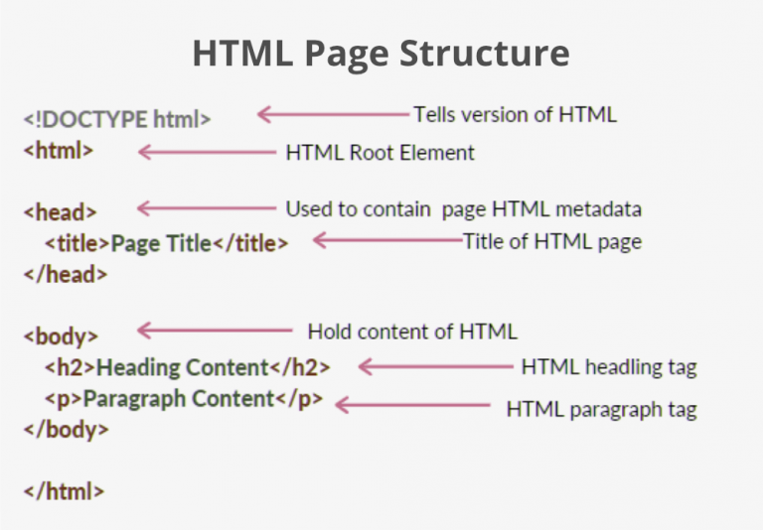

Slide 6
Tags and Elements
Tags come in pairs, they have both opening(< >) and closing(</ >) tags.
For Ex:
Headings (<h1> to <h6>)
Paragraphs (<p>)
Images (<img>)
Links (<a>)
Lists (<ul>, <ol>, <li>)
Divisions (<div>)

Slide 7
HTML Attributes
HTML attributes provide additional information about HTML elements.
The “href” attribute of <a> specifies the URL of the page the link goes to.
The “src” attribute of <img> specifies the path to the image to be displayed.
The “width” and “height” attributes of <img> provide size information for images.
The “alt” attribute of <img> provides an alternate text for an image.
The “style” attribute is used to add styles to an element such as colour, font, size etc.
The “lang” attribute of the <html> tag declares the language of the Web page.
The “title” attribute defines some extra information about an element.

